Slide 1
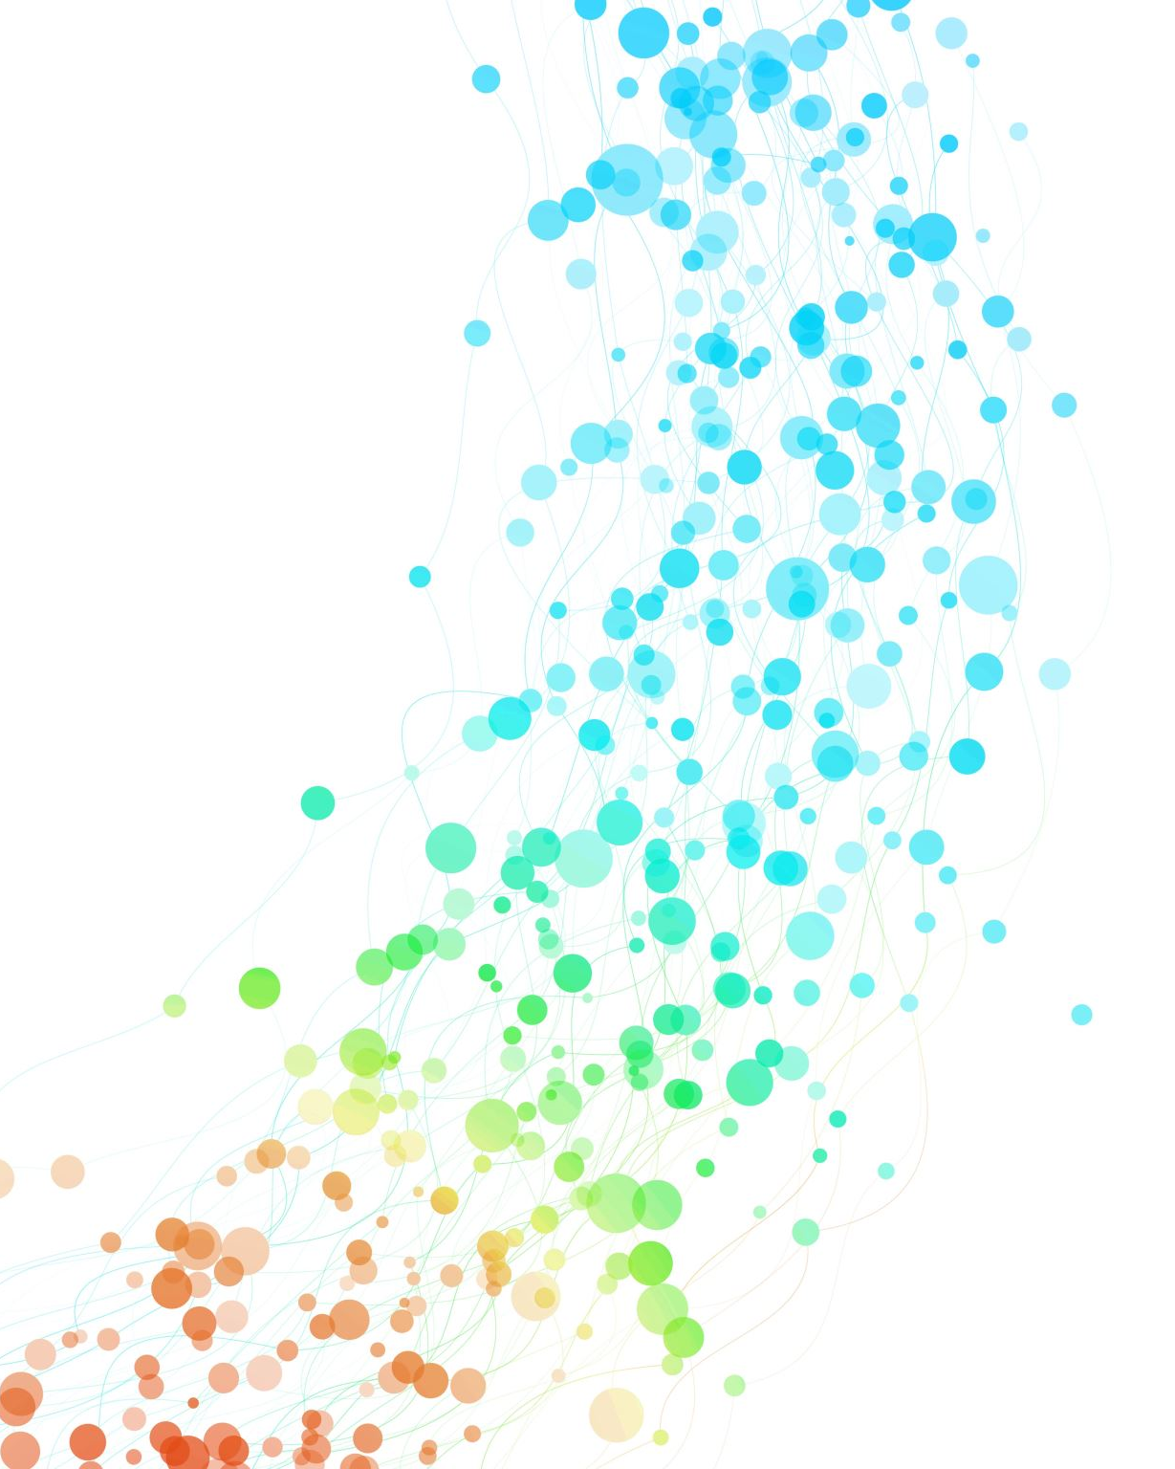
Creative Process
Or at least a version of it
There are many creative processes
This is the one I have been told to teach you
No, I am not being controlled by someone else… I do have free will…

Slide 2
The steps of the Creative Process
Requirements,
Plan,
Design,
Build,
Review,
Iteration

Slide 3
Requirements

Slide 4
Requirements – what do you want?
What do people want?
  Well, the simple answer is people are too stupid to know what they want
    I will come back to this point many, many times in the future

Slide 5
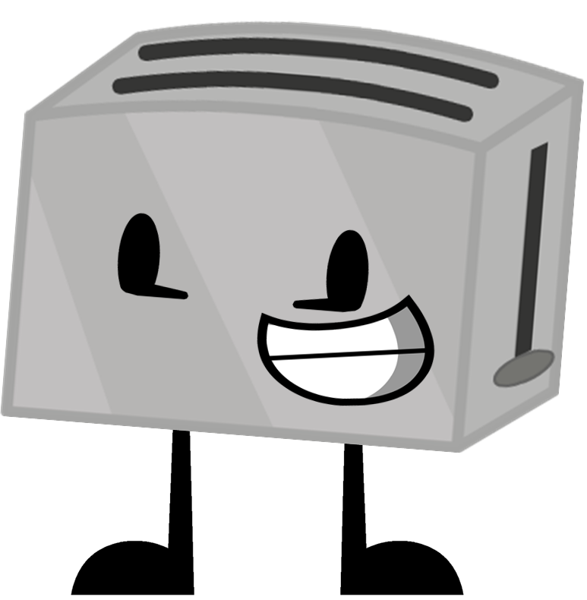
Example of people being stupid
I want AI built into my toaster!

Slide 6
Oh, what the place other than heaven – lets make a “smart” Toaster

Slide 7
Let's make a list of requirements
Obvious
Toaster must be able to take 1 or more slices of bread and cook it
Toaster must not burn peoples fingers off when touching the toaster while it is cooking bread
Less Obvious (?)
Toaster most not use more than 1KWs of electricity when running
Toaster must use AI to determine the correct level of tostieness for a 6-user household

Slide 8
Functional vs Non-Functional
Functional
Non-Functional
What the system should do
  Toaster must be able to accommodate 2 slices of standard sized bread
  Toaster must be able to detect the level of toastiness
  Automatically switches off when toast reaches the correct level of toastiness
  Must have LED lighting system which can change colour depending on users mood
How the system should function
  Toaster should use less than 1KW of power
  Must meet current UK safety standards
  Casting and shape of the toaster must be attractive
  Toaster should take no more than 5 seconds to reach desired temperature
  Internal camera must not degrade under normal heating conditions

Slide 9

Feature creep
Sometimes when doing a project the requirements can grow
This can be because:
  The scope or funding improves
  People realise they can include additional things by doing things differently
  People are stupid and just want more stuff

Slide 10
You know what would be “cool”?
How about if the toast is automatically put into the toaster for you?
How about an AI drone that flies to your bread bin, picks up the bread, and puts into the toaster so you can order toast early?
What if you could print custom images into the toast?

Slide 11
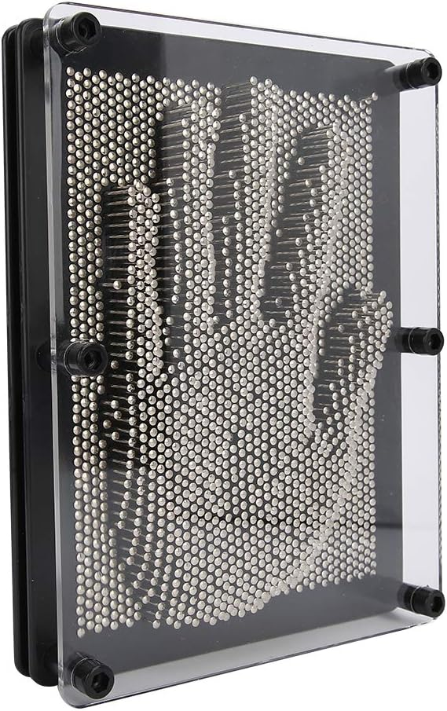
How to do custom images on toast?
There is a hand mold toy that can be used to create images by pushing pins
These pins could be heated to burn the toast
The images could be uploaded to the toaster
WIFI? USB? Both?

Slide 12
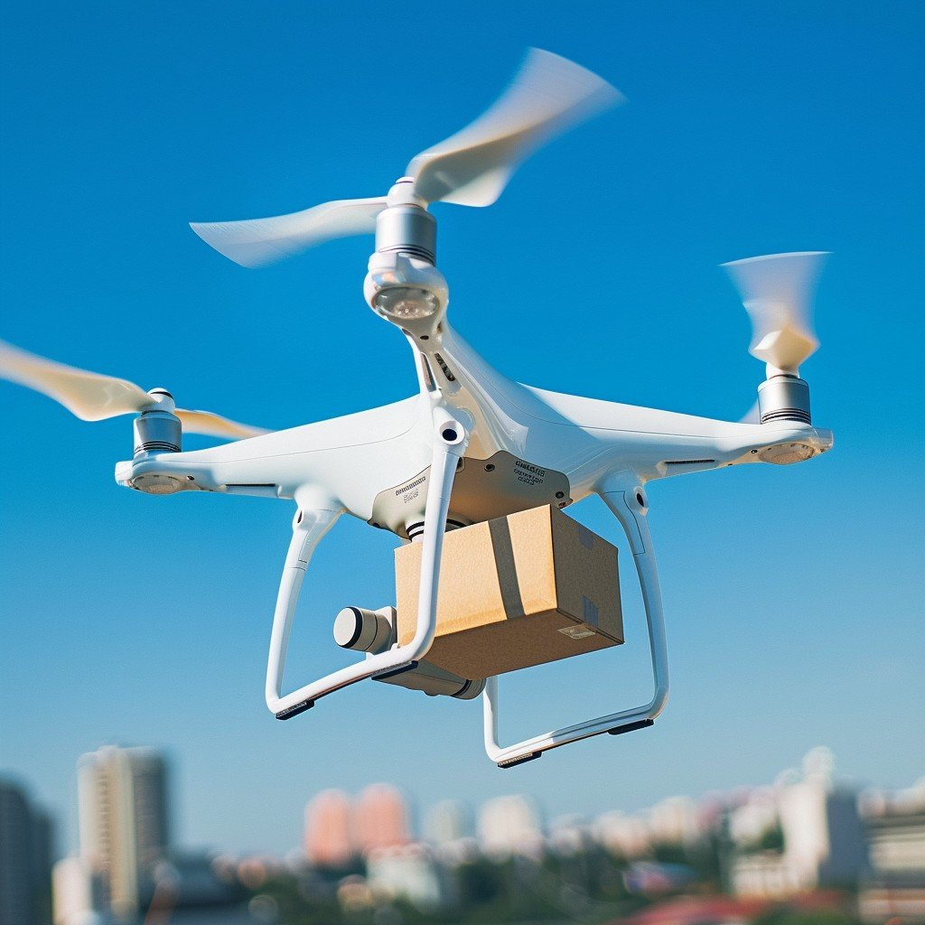
Bread carrying drone
Drone has to be small enough to fly around a kitchen
Capable of visually identifying bread
Capable of picking up bread without destroying it

Slide 13
Planning

Slide 14
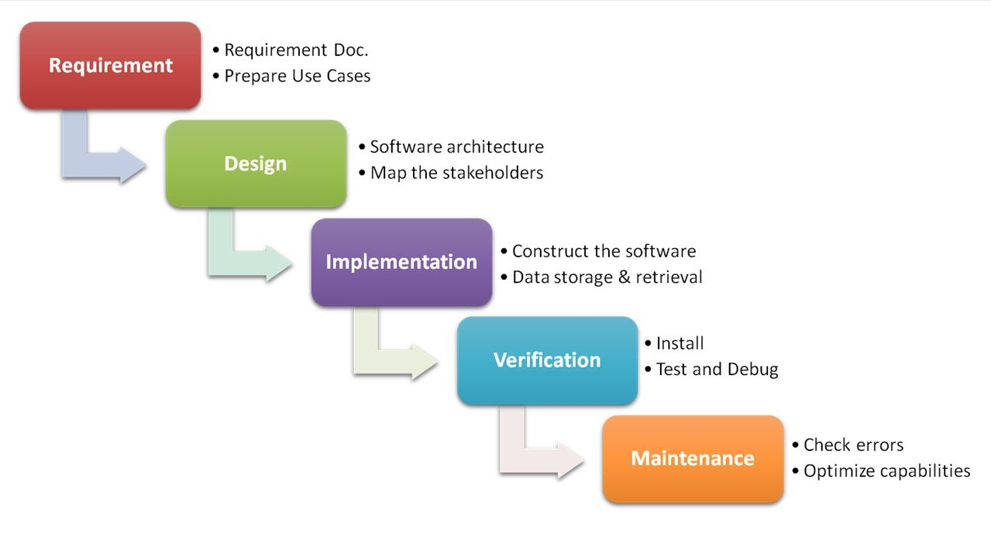
Waterfall methodology

Slide 15
Advantages
Disadvantages
Simplicity: Easy to understand, plan, and manage due to its rigid structure.
Upfront Planning: Costs, timelines, and resources can be accurately estimated early on.
Clear Milestones: Progress is easily measurable as each phase has a defined start and end.
Strong Documentation: Creates a clear project record and knowledge base for future reference.
Inflexible: Highly resistant to change—if requirements change mid-project, it requires extensive, costly rework of previous phases.
Late Feedback: The customer only sees a working product and provides final feedback after the entire build is complete.
High Risk: Major errors (e.g., misunderstanding requirements) are often discovered late in the testing phase, making them expensive to fix.
Long Delivery: No working product is delivered until the very end.

Slide 16
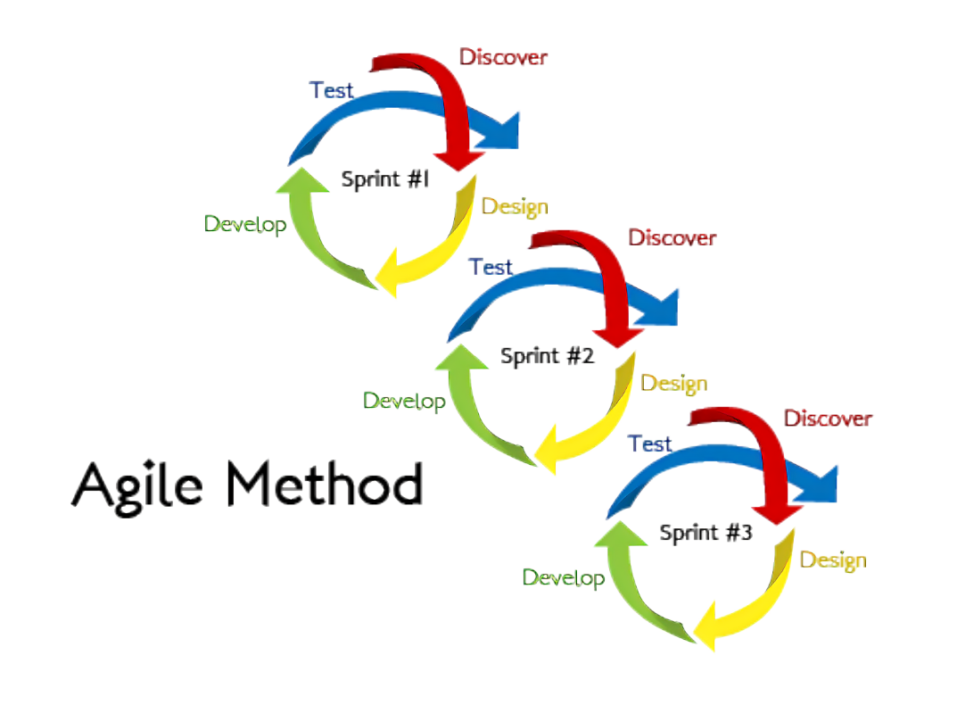

Slide 17
Advantages
Disadvantages
High Adaptability: Teams can quickly and easily respond to changing requirements, market conditions, or customer feedback, even late in development.
Reduced Risk: Frequent delivery of working increments allows defects and problems to be detected and fixed early, preventing minor issues from escalating.
Increased Team Morale: Self-organizing teams have greater autonomy and ownership, leading to higher engagement and productivity.
Lack of Predictability: The flexible scope and short-term planning make it difficult to accurately predict the final cost, schedule, and complete feature set at the start.
Risk of Scope Creep: The emphasis on accepting change can, without strong product ownership, lead to uncontrolled additions of features, which balloon the project's scope.
High Dependency on Customer: Success relies heavily on the Product Owner or client being available and committed to providing timely, clear feedback throughout every iteration.

Slide 18
Design

Slide 19
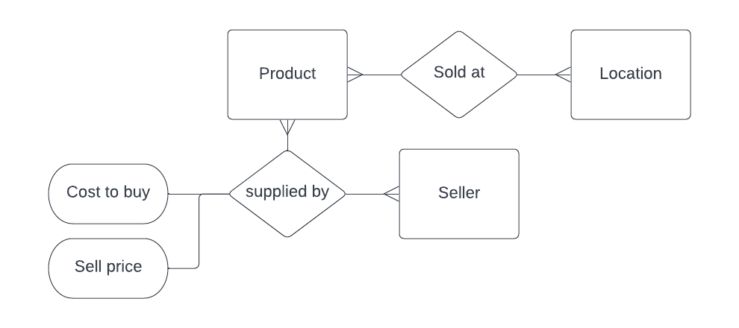
conceptual diagram

Slide 20
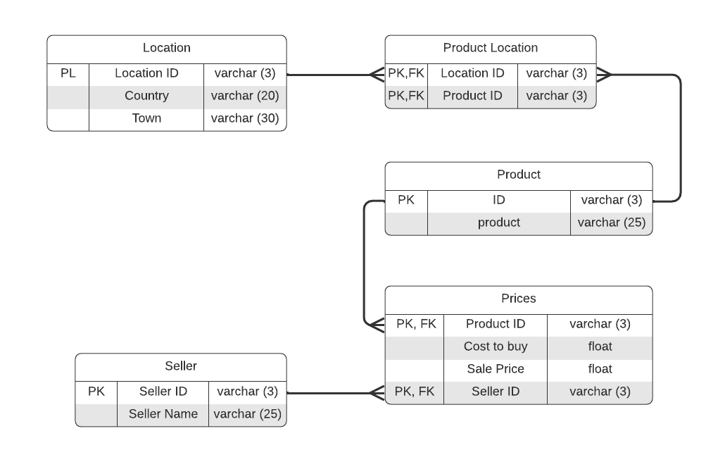
Physical Diagram

Slide 21
Physical Diagram

Slide 22
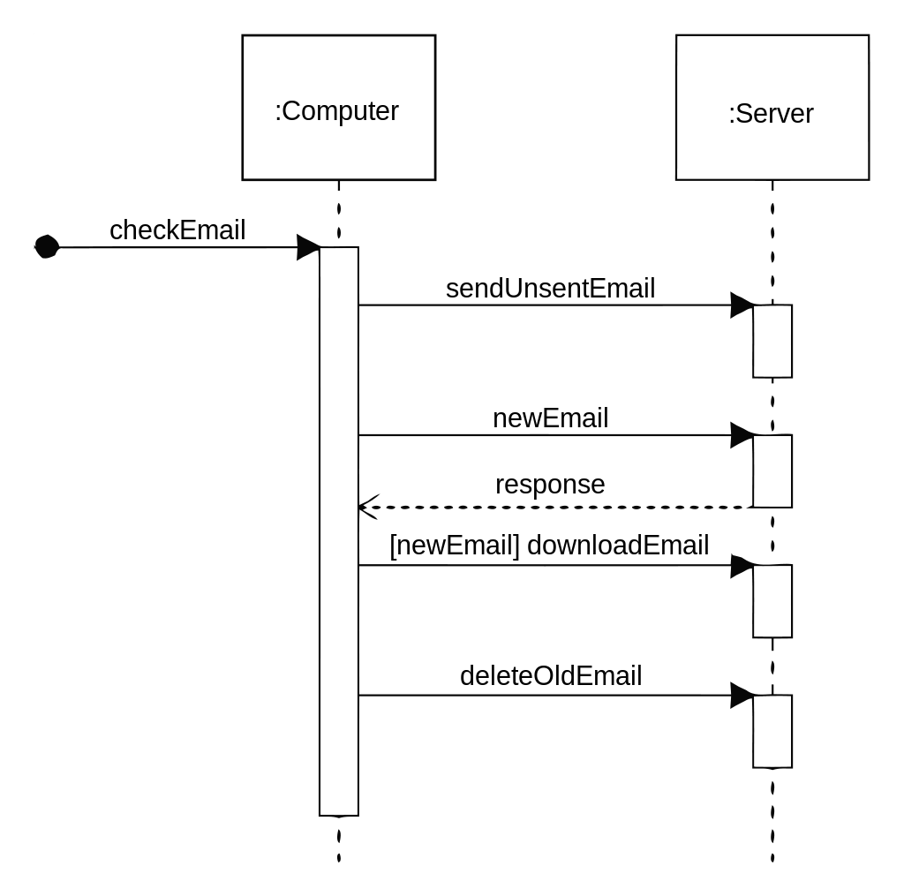
Sequence diagram
Sequence diagrams show the order that messages flow throughout a digital system, and which objects they interact with

Slide 23
Sequence diagram notation
SomeMessage
Messages can also be returned to the same system object - so objects can message themselves (e.g. timer function)
Asynchronous messages are denoted by an open arrowhead. These messages do not require a response before the next message is sent

Slide 24
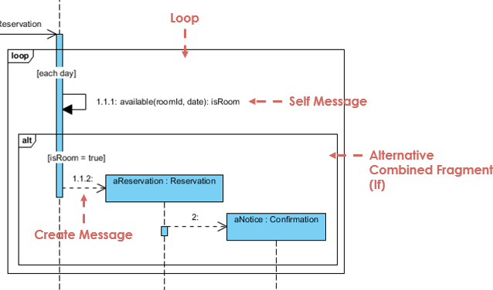
Sequence diagram notation
Loops and alternative routes are denoted by boxes and a small label in the top left hand corner showing if it is a loop statement or an alternative route

Slide 25
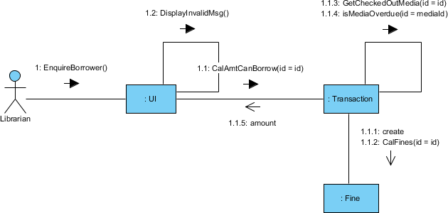
Communication diagram
Communication diagrams are somewhere between a sequence diagram and a conceptual ERD diagram.
They show the direction and flow of information through the system, but lays out the objects within a system in the style of an ERD

Slide 26
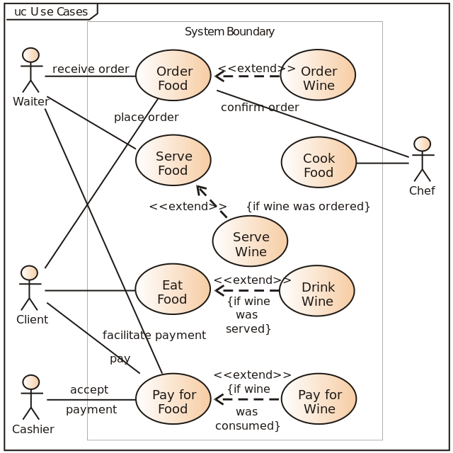
Use Case Diagram
Use case diagrams map different user journeys throughout the system, detailing the main interactions between each user and the system.
It also shows where 2 or more users might interact with the same system component at the same time.

Slide 27

Use Case Diagram
Stick figures are used to show users within the system
Ovals are used to show system interaction points, they are not detailed software just descriptions of tasks users will do within a system
Name of interaction

Slide 28
Use Case Diagram
All system objects should be contained within a box to show this is the system they are interacting with. All users should be external to that system.
Users are connected to these system objects via lines. There is no given order to the interactions listed.
Name of interaction
Name of interaction
Name of interaction

Slide 29
Use Case Diagram
System objects can have an extend or an include.
<<extend>> is other possible use case scenarios that branch off the original
<<include>> is where a use case requires another interaction to function properly
The direction of the arrow shows the direction of the use journey so an invaild password goes to the user, buying a product takes the user to a login page
Login
<<extend>>
<<include>>
Invalid password
Buy product

Slide 30
Use Case Diagram
Search
You can also show a mixture of generalised and child uses, where children either adopt parts of the parent or override parts of the parent.
This example is where two different search categories change the behaviour of the parent
Search by title
Search by author

Slide 31
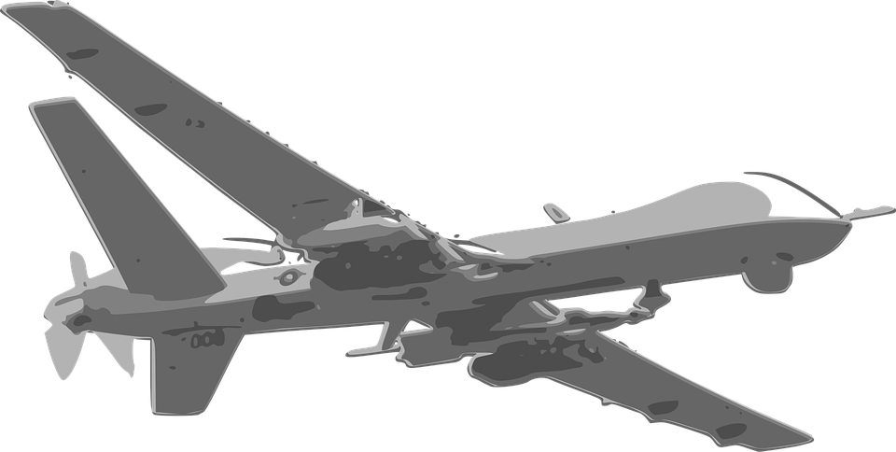
Smart Toaster UML
<<include>>
Image Upload
Image selection
<<extend>>
Toast Request
<<extend>>
Bread Collection Toaster
Breaded project selection
Bread Delivery User

Slide 32
Results
We now have a toaster, with an AI control system
  With a heat reenforced camera to monitor the toast
  Onboard storage for different images for toast patterns
  A drone that flies around the kitchen
  And Ha-Satan knows how many other features we’ve come up with
  Total cost to customer, £3,500

Slide 33
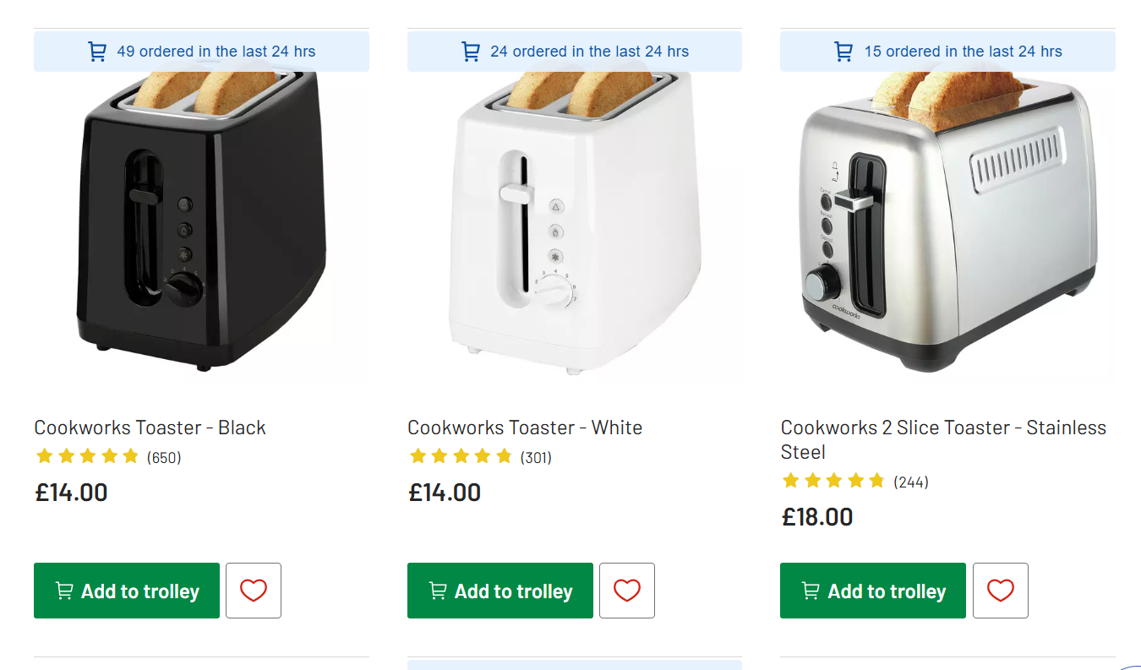

Slide 34
Everything went wrong…
With the requirements stage
Once people start adding unnecessary things to the end product it is destined to fail from the outset
While failing to plan, is planning to fail, failing to plan well is just as bad.

